Slide 2
Realtime perception of an autonomous Racecar
Tobias Bosl
Tjorven Burdorf
Vincent Guttmann
Lukas Kraft

Slide 3
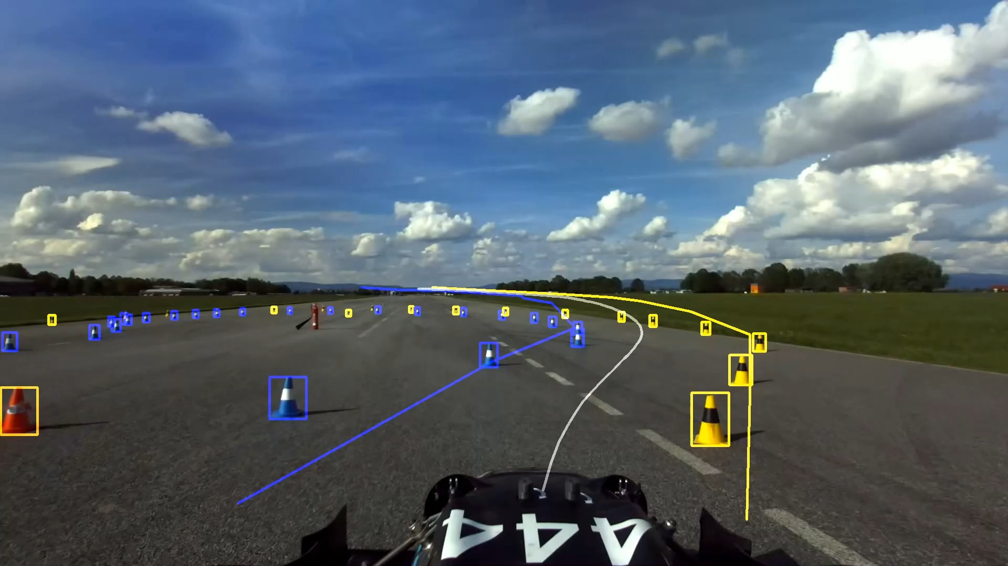

Our Project
Perception of an autonomous racecar
Camera based
Using Yolov8
Basis for localization and trackplanning

Slide 4
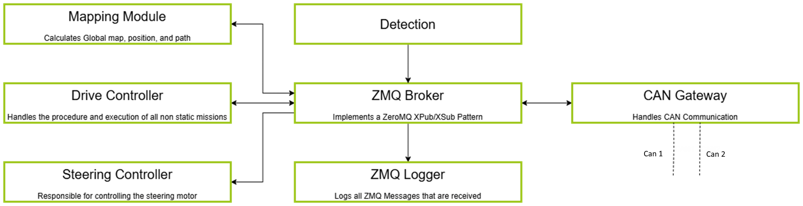
Driverless Architecture

Slide 5
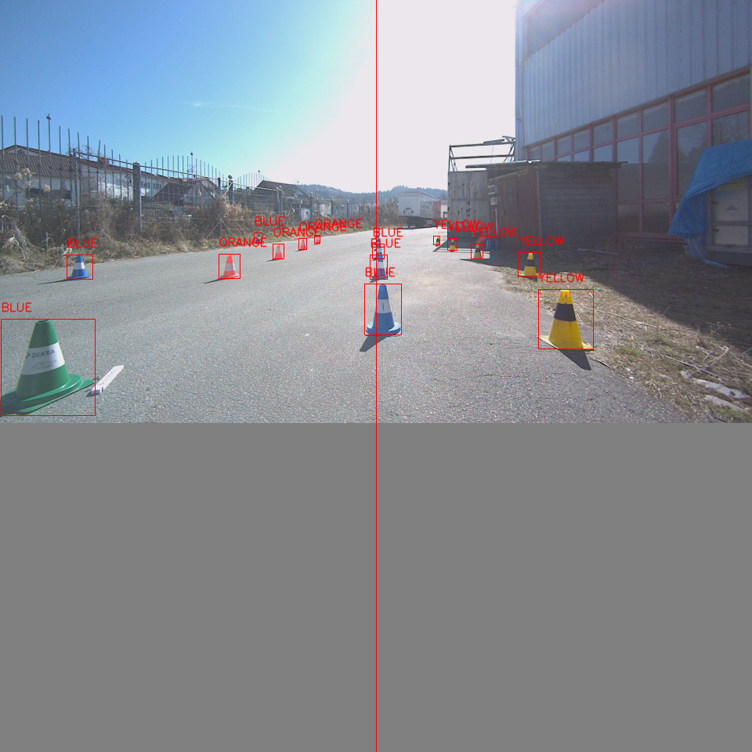
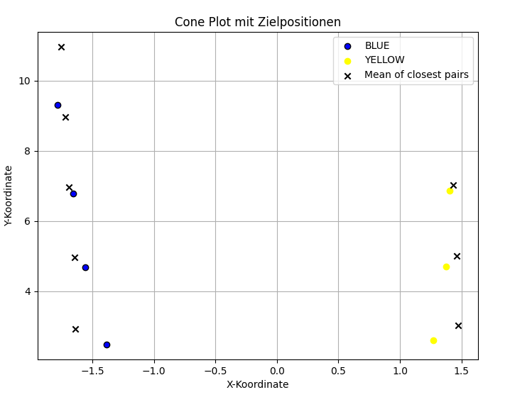
Main Components
Detection
Projection

Slide 6
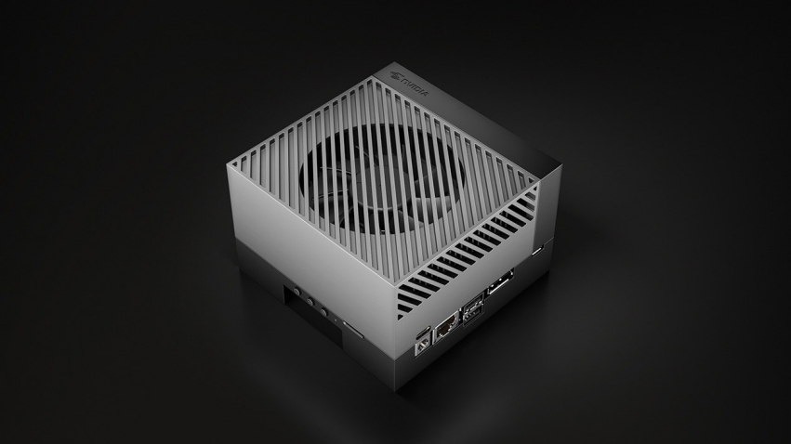
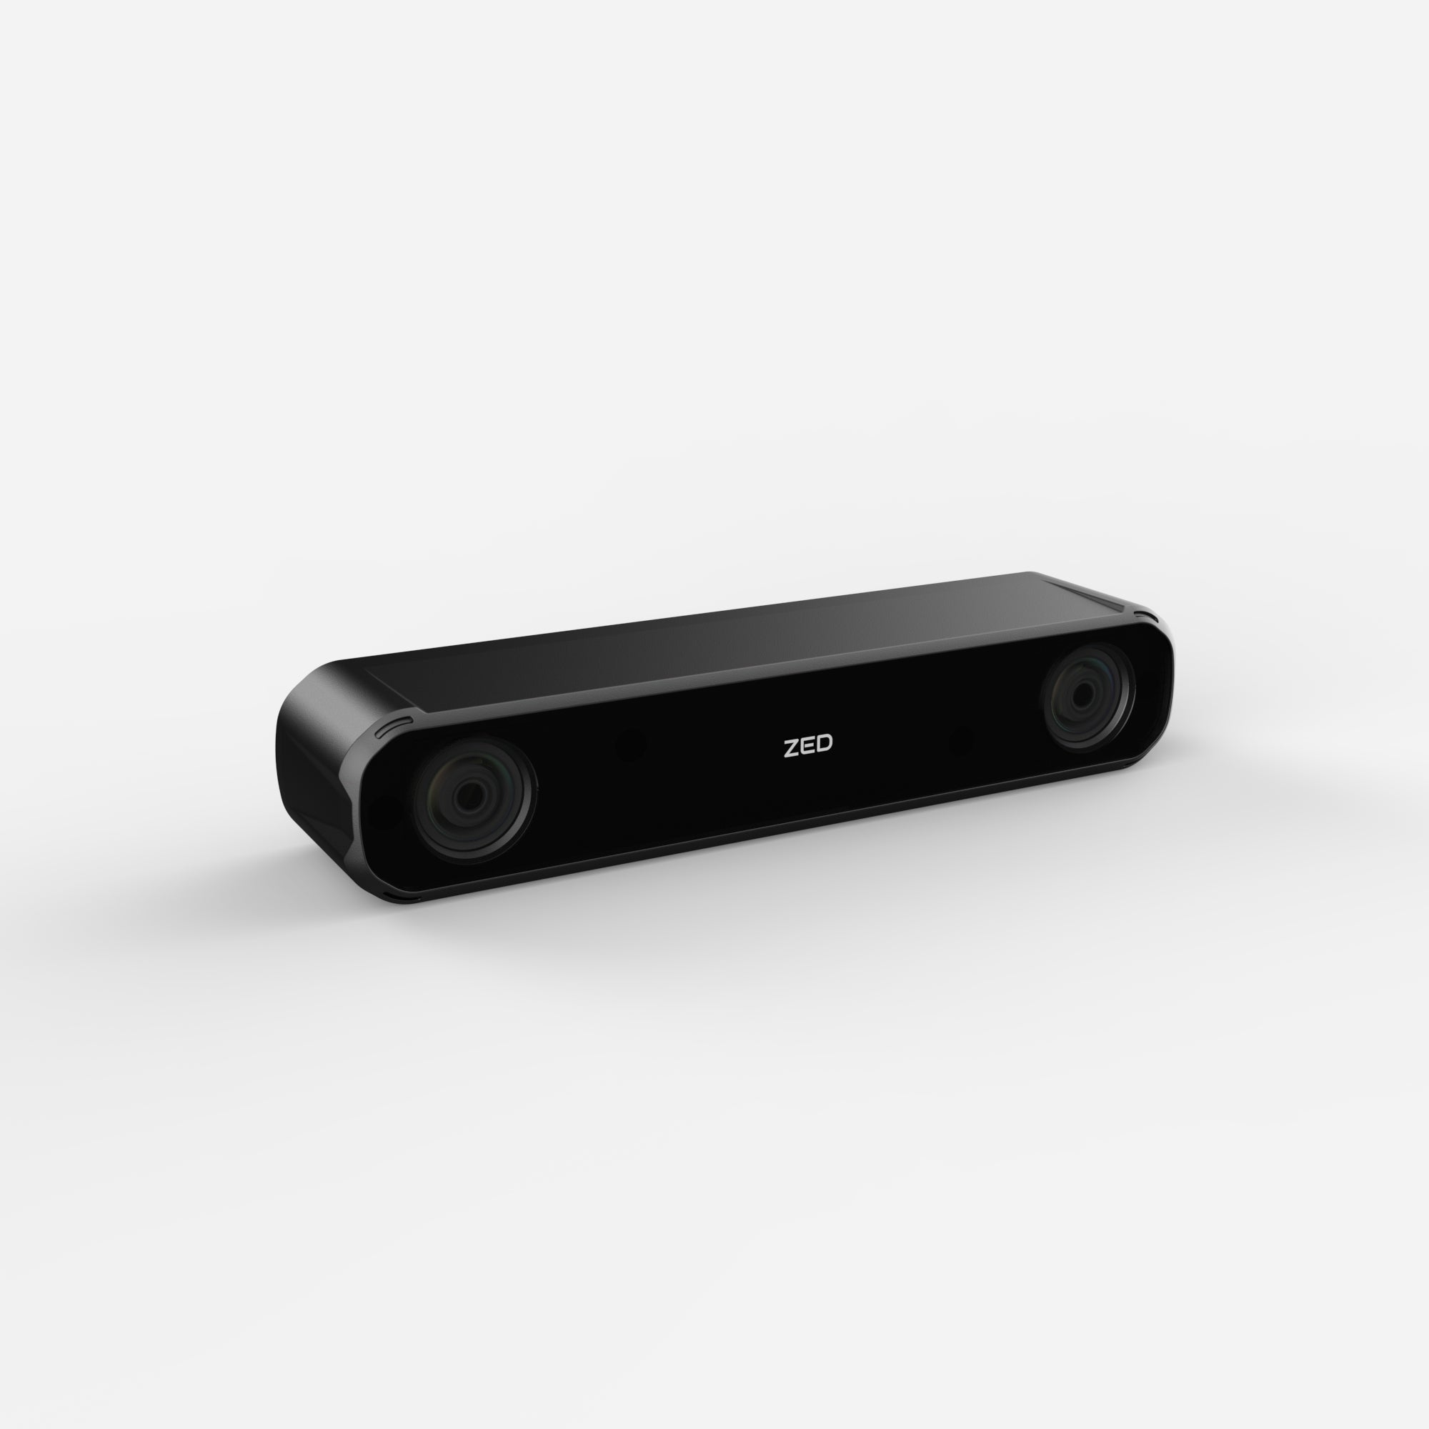
Prerequisites - Hardware
Driverless computer
Camera

Slide 7
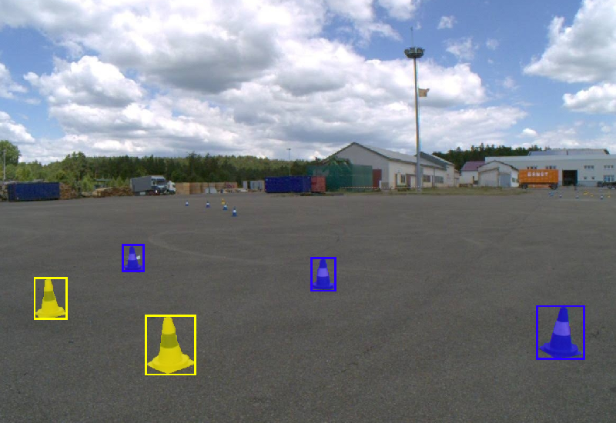
Prerequisites - FSOCO dataset
Shared Dataset for fomular students
For cone detection

Slide 8
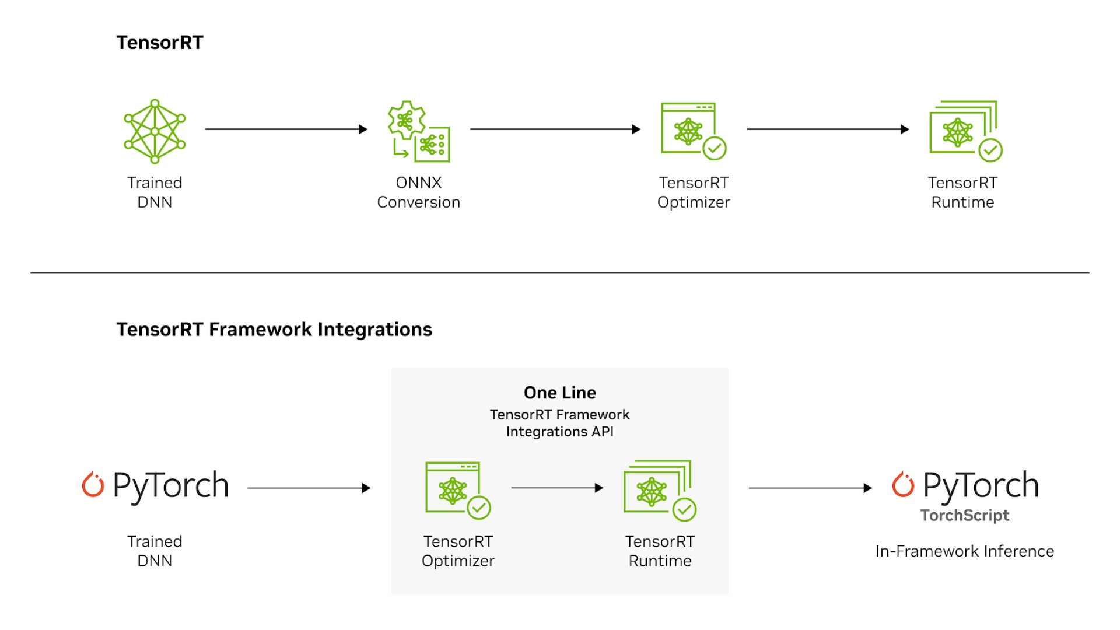
Prerequisites - TensorRT
Ecosystem developed by NVIDIA
Optimizes neural networks for fast inference
Builds it‘s own TensorRT Engine

Slide 9
Implementation - creating Model
Train Yolov8 on FSOCO dataset
960 x 960 pixel
FP16
Convert trained .pt file over .onnx to seriealized .engine

Slide 10
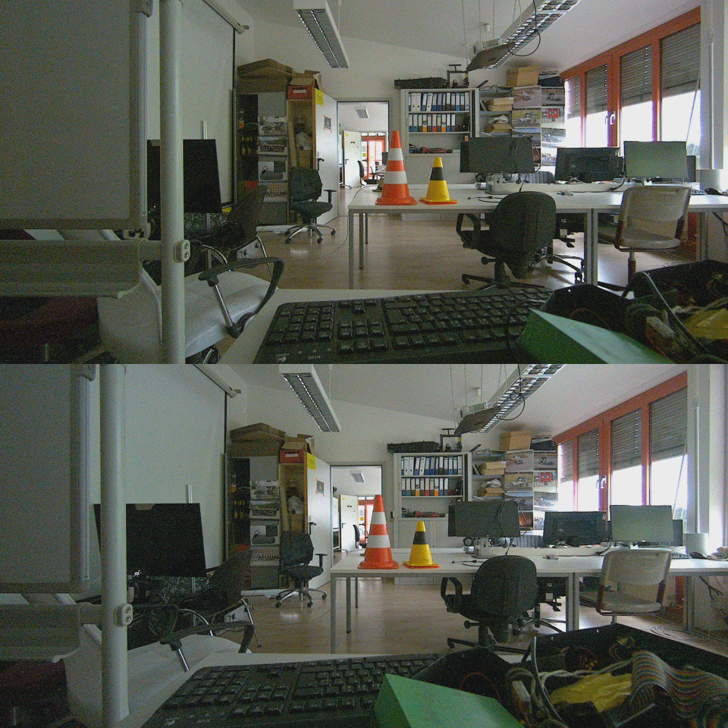
Implementation - Preprocessing
Crop both images to 2:1 format
Combining both camera images vertically
Change colormode to BGR
Flatten the data to a float vector
Normalize the float vector

Slide 11
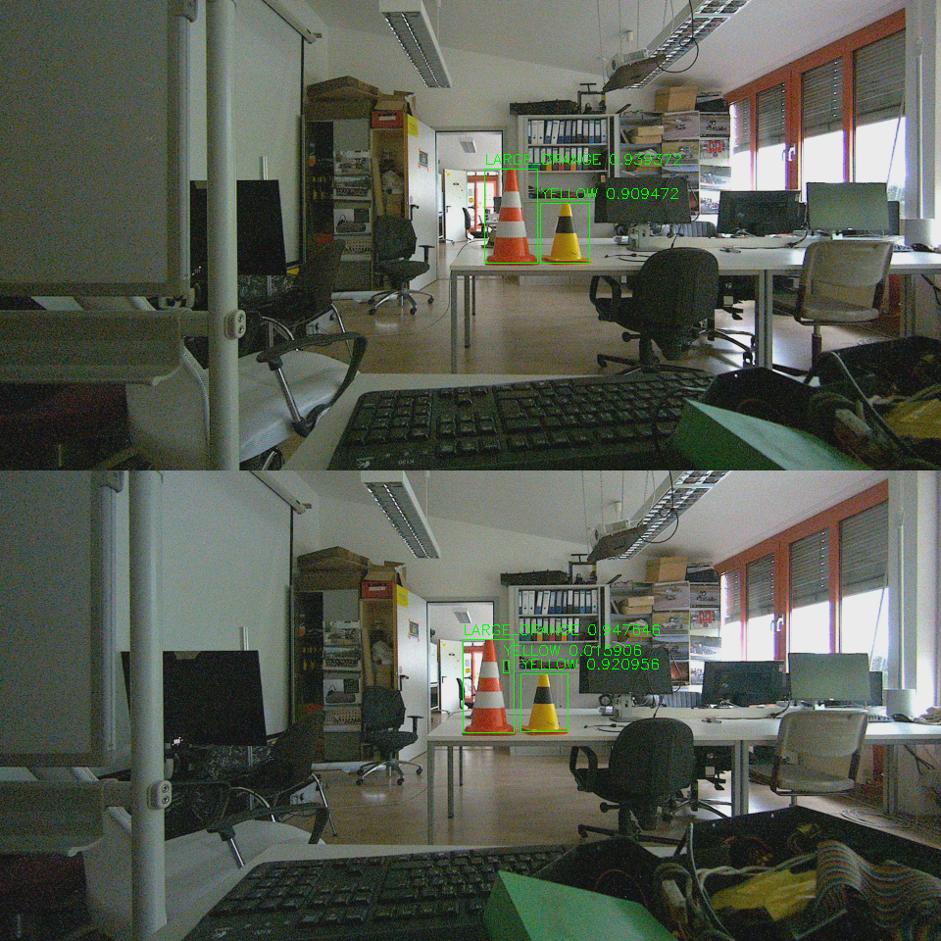
Implementation - Infer

Slide 12
Implementation - Postprocessing
Delete redundant boxes via Non Maximum suppresion
Sort list by confidence
Calculate intersection
Remove boxes with too much overlap
Assign bounding boxes to image
Recalculate boundingbox coordinates

Slide 13
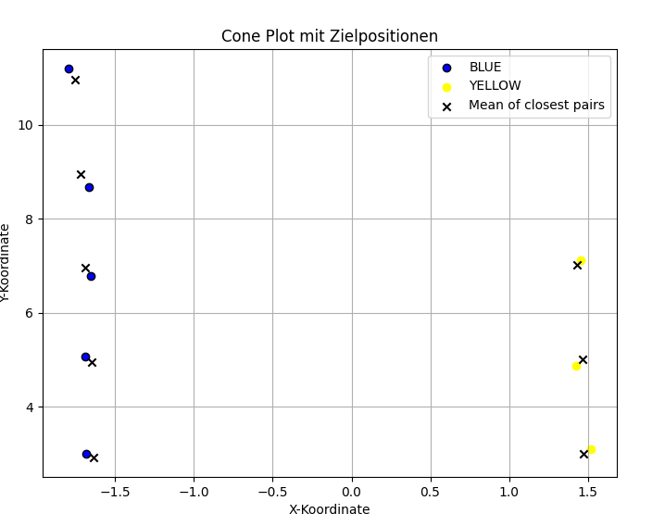
Implementation - Projection
Why Project Cones into the Real World?
Camera sees 2D image
autonomous driving requires 3D understanding
Cones mark the track boundaries
→ vehicle must estimate their relative distance and lateral position
Input: 2D bounding box → Output: cone position in vehicle coordinates

Slide 14
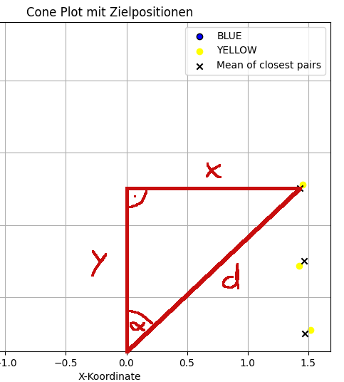
Depth and Angle Estimation from a Camera Image
Combine with angle between cone and current car orientation → triangle
Performance matters → no access to depth map from camera
Projection must rely on visual features like:
Cone height and width in pixels
Distance from bounding box to image borders
Position of bounding box center
Real-world cone height known → allows simplified model

Slide 15
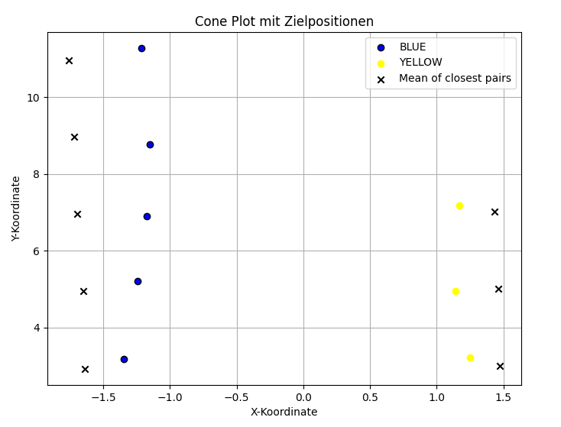
Improving Angle Accuracy with Undistortion
Raw projection can be inaccurate due to lens distortion
Angle between driving orientation and cones is distorted towards image border
Applied OpenCV undistortion using calibration matrix and distortion coefficients
This allows to calculate the angle between car orientation and cone more presicely

Slide 16
Problems Regarding Distance Estimation
Bounding boxes do not have same ratio between height and width always

Slide 17
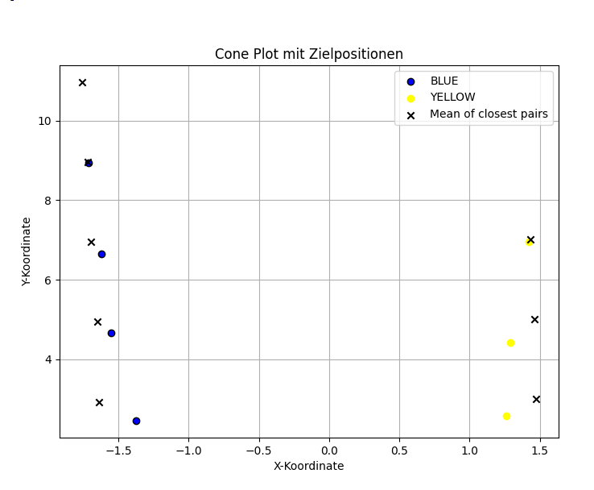
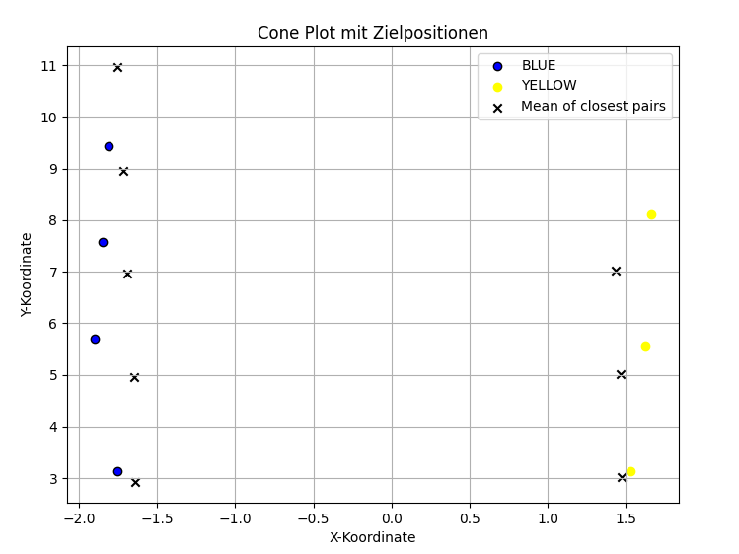
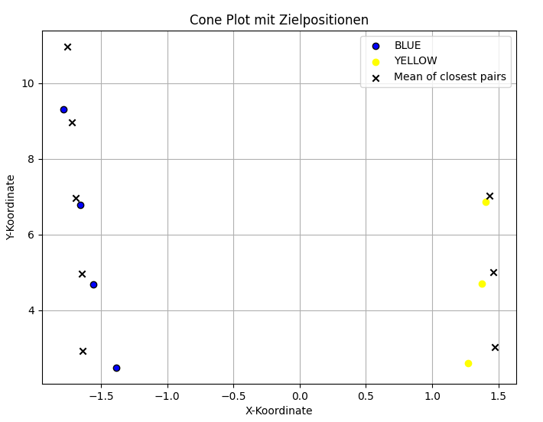
Depth Estimation
Due to the problems just listed precise calculation almost impossible
Tested three approaches to find the closest results based on
Height and width of bounding box compared to height and width of actual cone
Distance between lower bounding box border and lower image border
Pinhole-Based Distance Estimation
Neither of them was good alone
All had some spots with better and some with worse quality

Slide 18
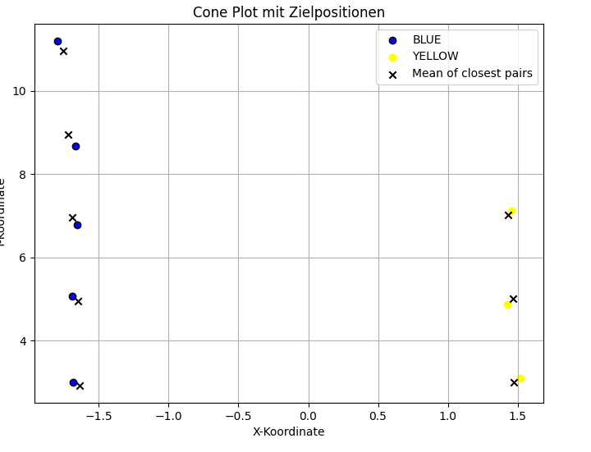
Optimizing the Results
Error observed between calculated and actual distances
Linear regression to adjust outputs based on real measurements
Result: Weighting the three approaches differently to get closer to the actual position

Slide 19
Demonstration

